Slide 1
Customer Behavior Analysis

Slide 2
Problem Statement:
Shop Easy, an online retail business, is experiencing a decline in customer engagement and conversion rates, despite investing heavily in marketing campaigns.
The company has observed:
Reduced Customer Interactions
Decreased Conversion Rates
High Marketing Expenses
Customer Feedback Gaps

Slide 3
Customer Journey & Engagement Analysis

Slide 4
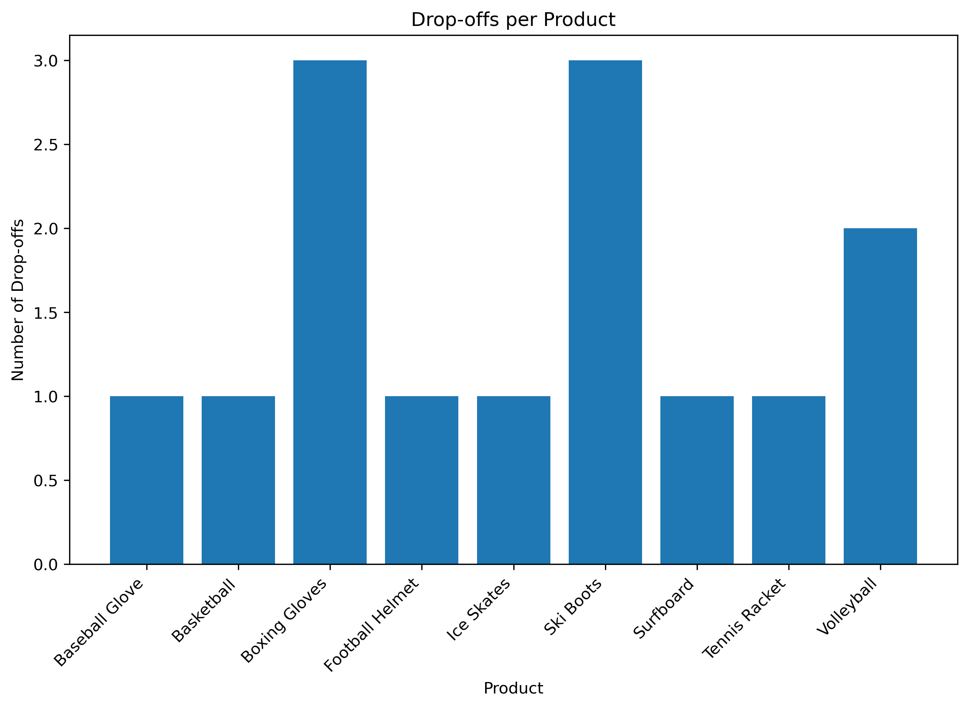
Recommendations
Fix High Drop-off Products (Boxing Gloves & Ski Boots): Improve sizing guides, add detailed specs, and include demo videos to reduce confusion.
Enhance Trust Factors: Highlight return/refund policies, warranties, and showcase authentic reviews with photos.
Smooth Checkout Process: Reduce steps, show total cost (including shipping) upfront, and offer multiple payment options.

Slide 5
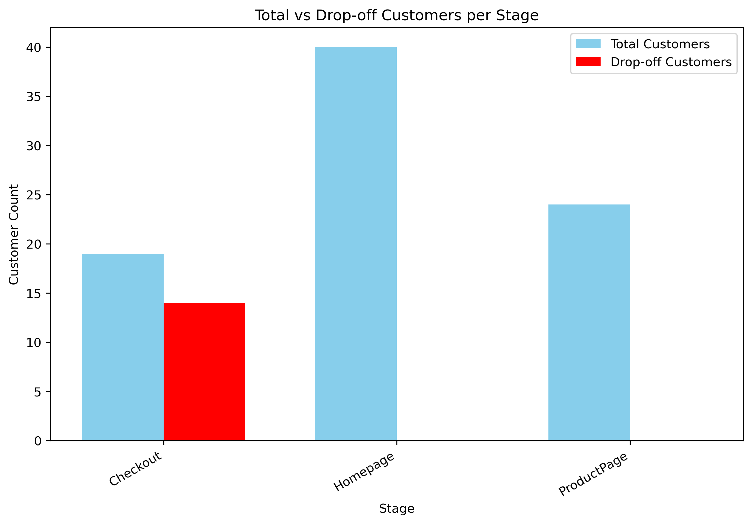
Recommendations
Display secure payment icons (SSL, verified gateways).
Highlight return policies, free shipping thresholds, and delivery timelines.
Offer time-limited discounts or free shipping to encourage completion.
A/B test different checkout designs and payment flows to find the most effective setup.

Slide 6
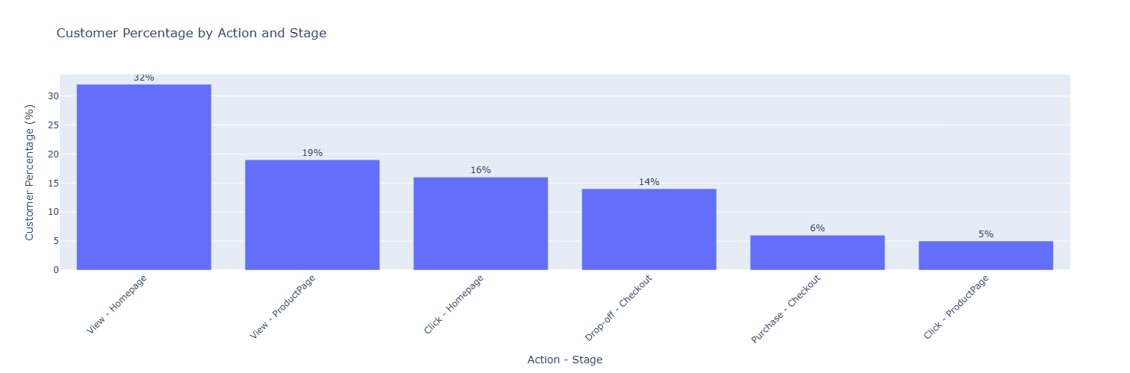
Recommendations
Use clear CTAs, personalized product recommendations, and highlight popular/best-selling items.
Add detailed descriptions, better visuals (images/videos), and customer reviews to boost confidence.
Simplify checkout steps, allow guest checkout, and show upfront costs (shipping, taxes).

Slide 7
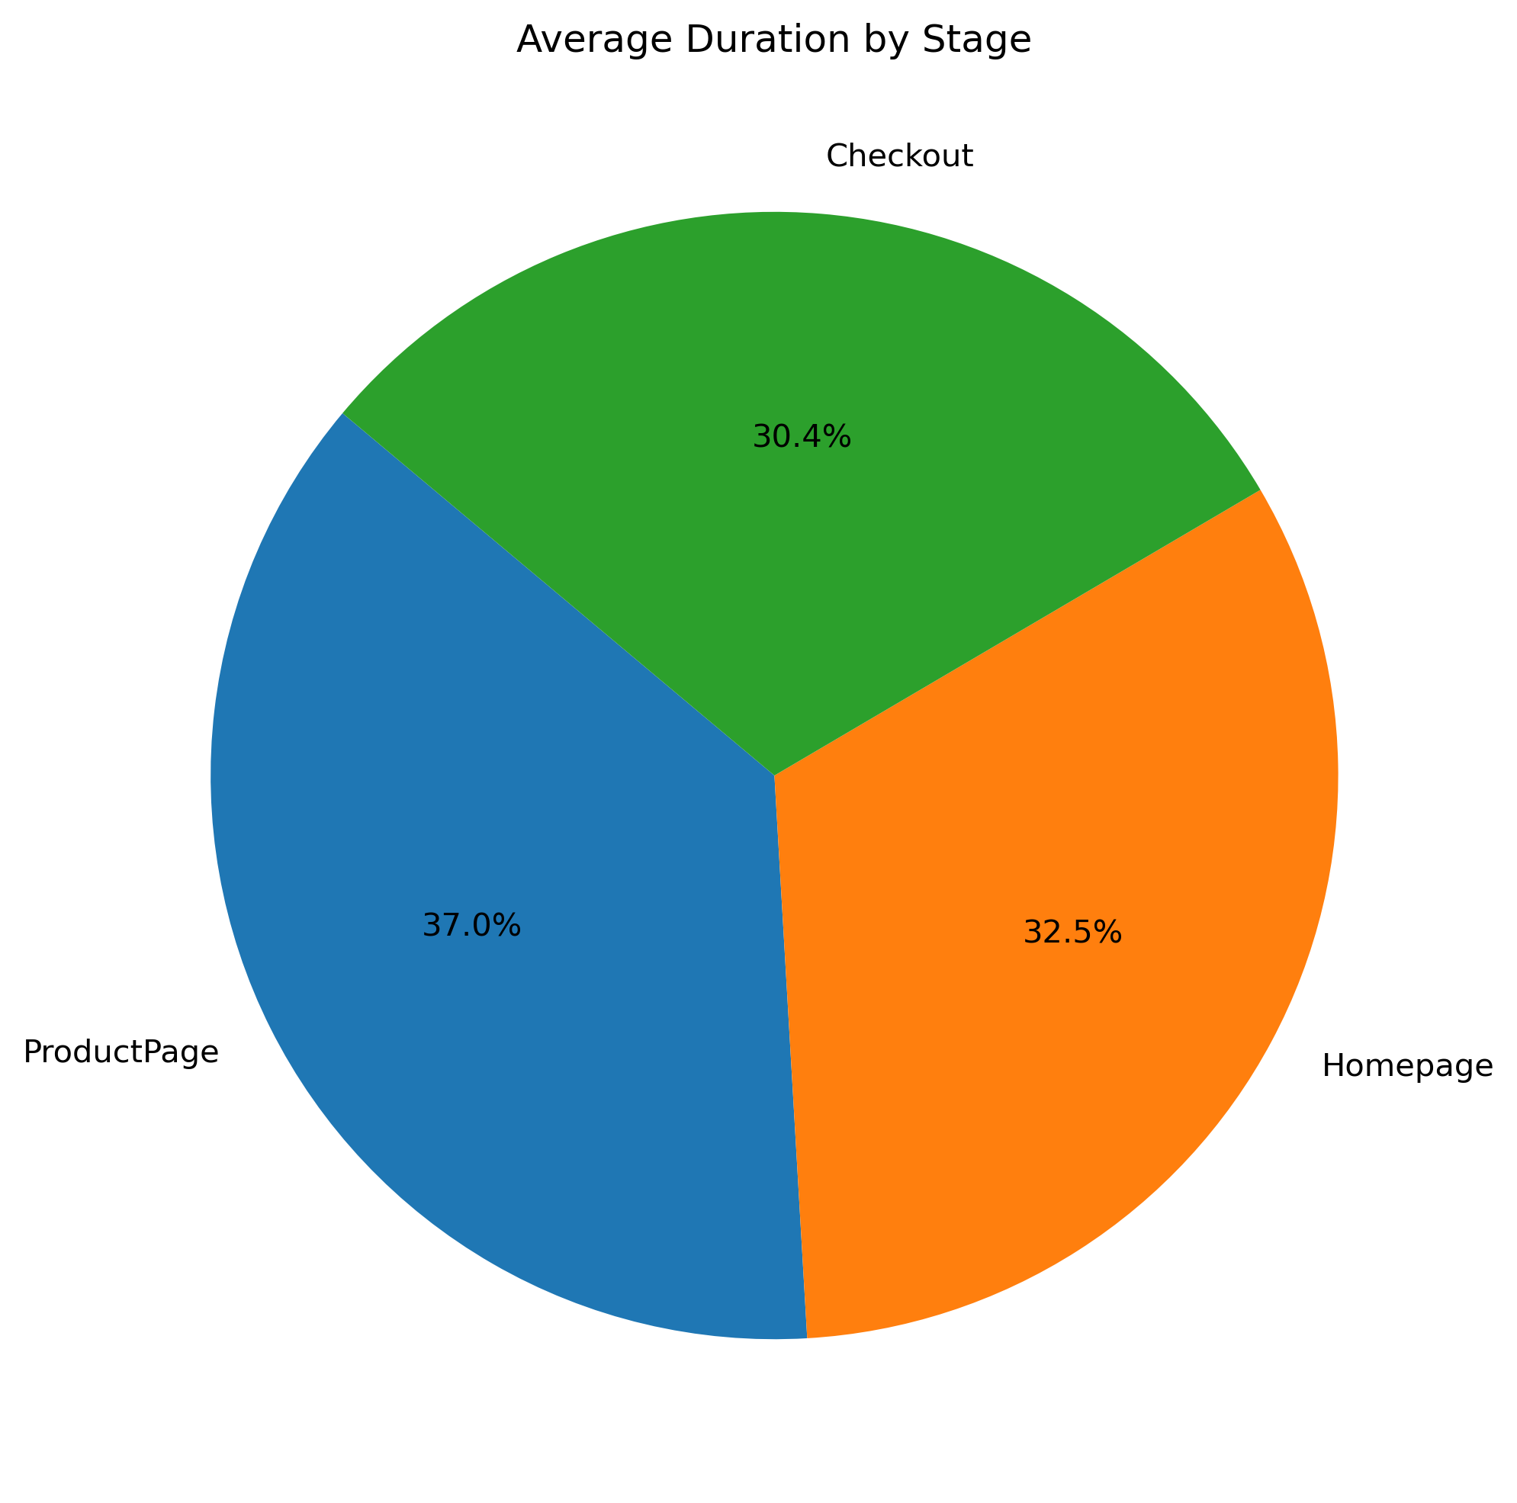
Recommendations
Since customers spend the longest time here, ensure product details are clear, well-structured, and engaging (videos, FAQs, reviews).
Guide users quickly to relevant products with strong CTAs, personalized recommendations, and intuitive filters/search.
Even though time spent is lower than product page, checkout should be faster—enable autofill, saved addresses, and guest checkout to reduce friction.
Recommendations

Slide 8
Customer Reviews Analysis

Slide 9
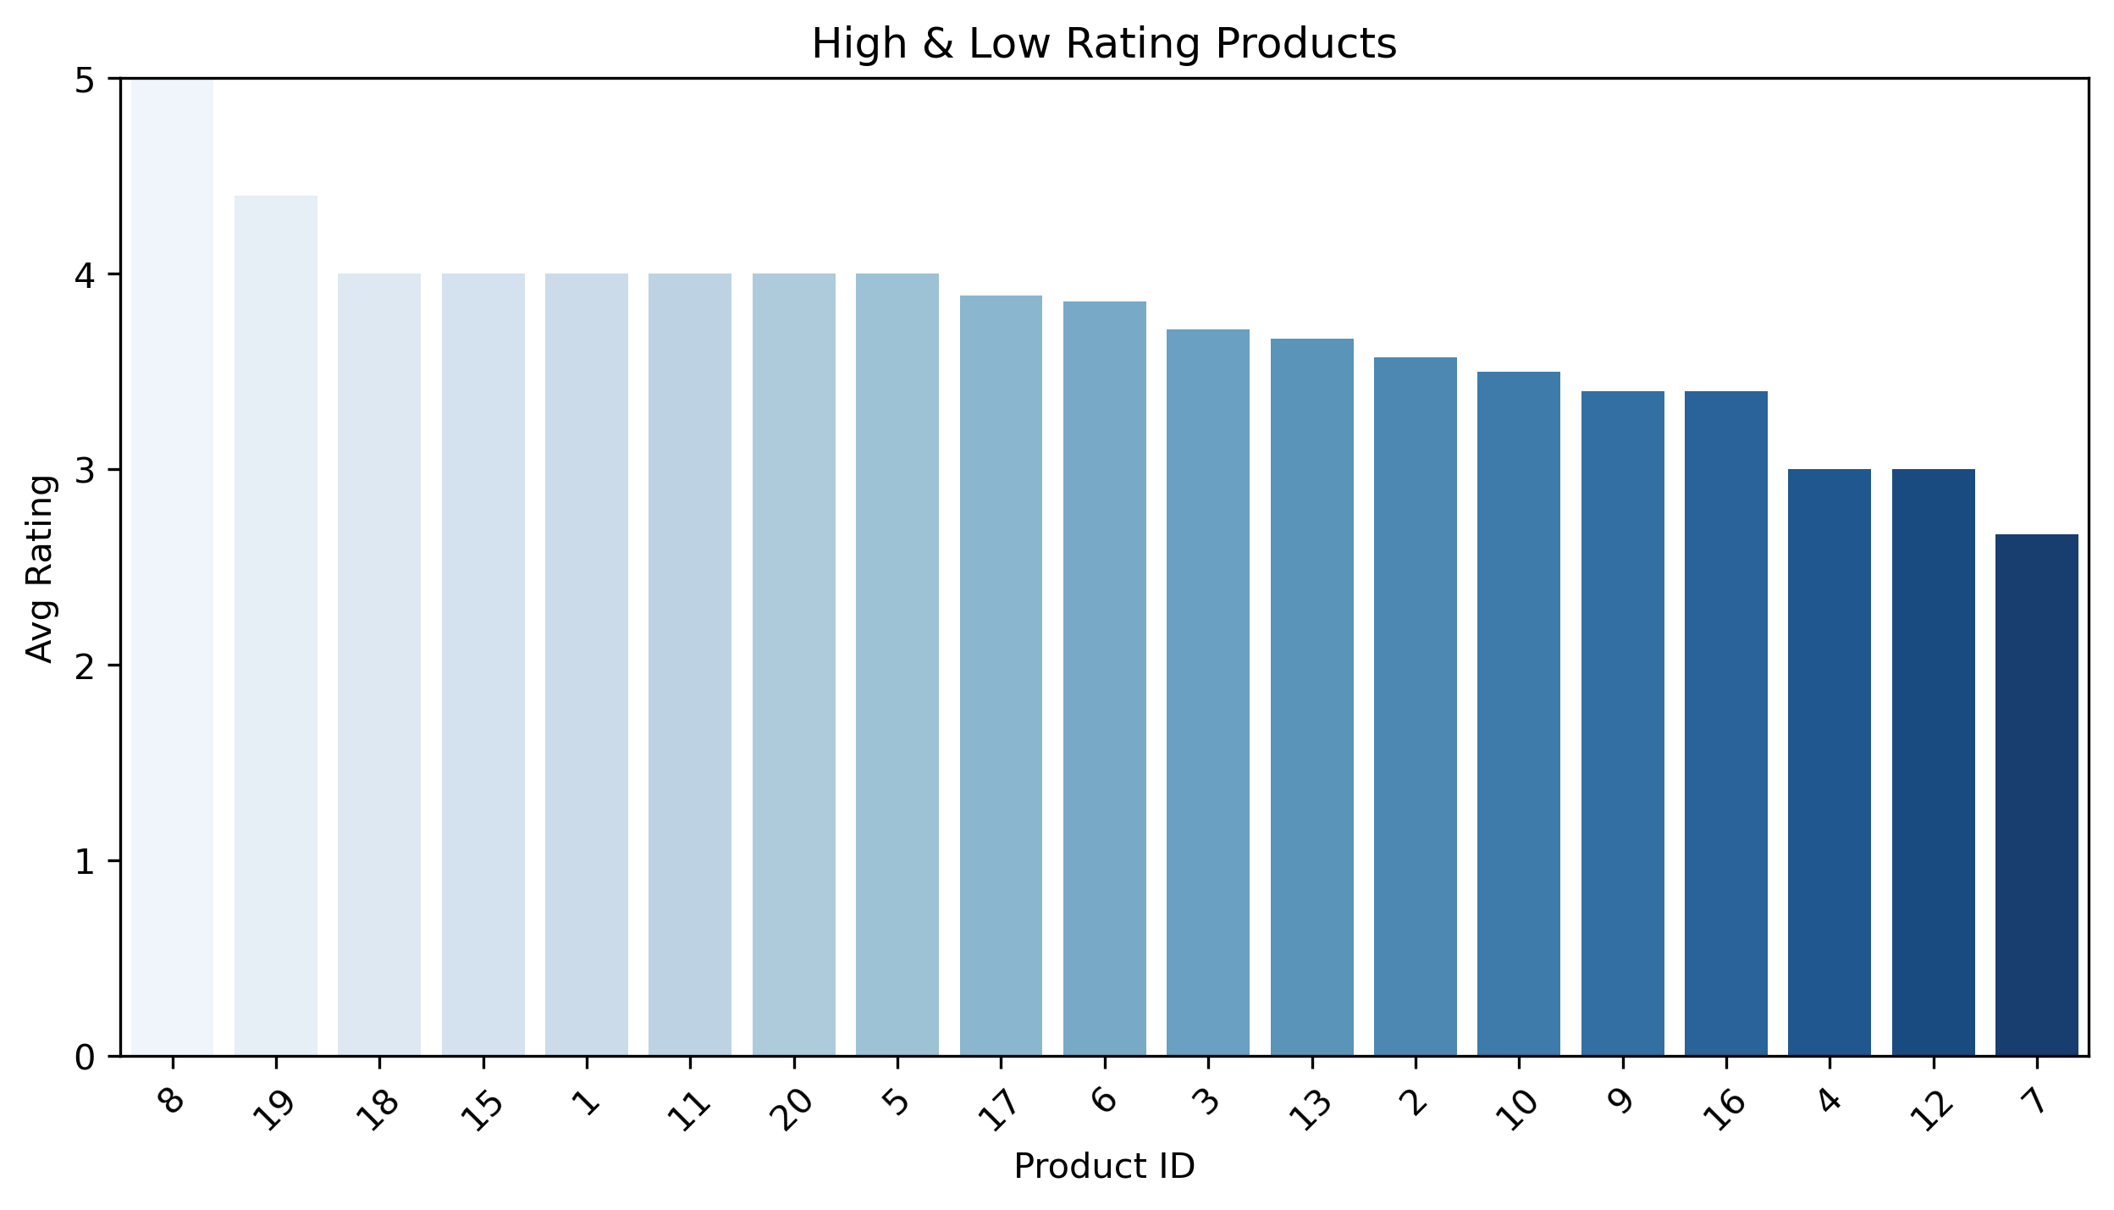
Recommendations
Fix low-rated products first. Analyze their negative reviews to address quality or description issues.
Highlight and promote your top-rated items. Use them in marketing to build trust and set quality standards.
Use reviews to guide future decisions. Let customer feedback directly influence which products you sell and how you describe them.
Recommendations

Slide 10
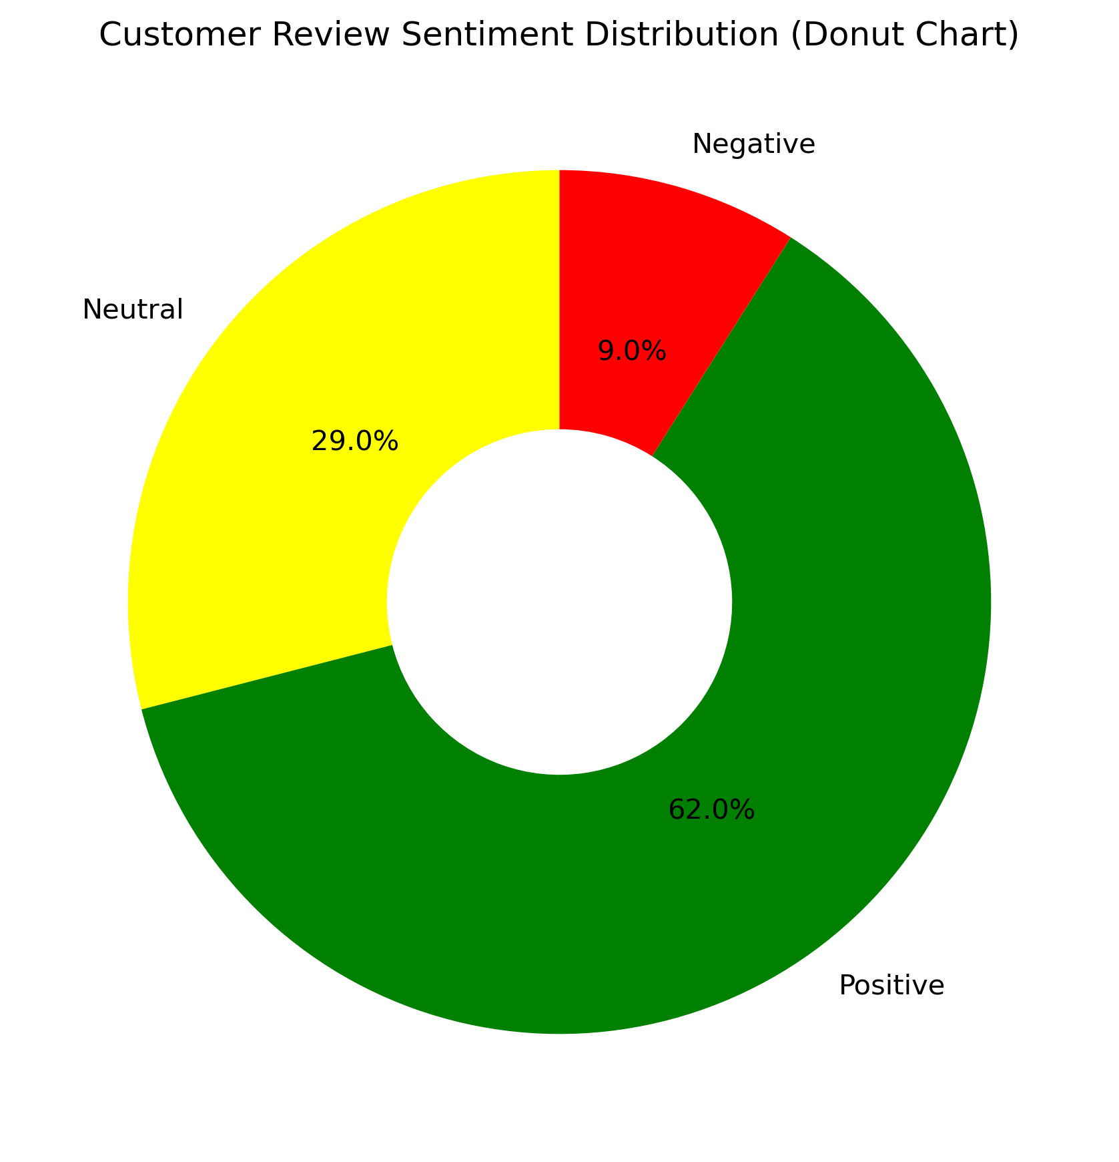
Recommendations
Celebrate and reinforce success. A majority (62%) of reviews are positive. Thank these customers and encourage them to share their experiences.
Prioritize resolving negative feedback. Address the 9% of negative reviews quickly to prevent issues from recurring and show you value customer concerns.
Engage with neutral reviewers. The 29% are undecided. Follow up to understand their experience and try to win them over, converting them into positive advocates.

Slide 11
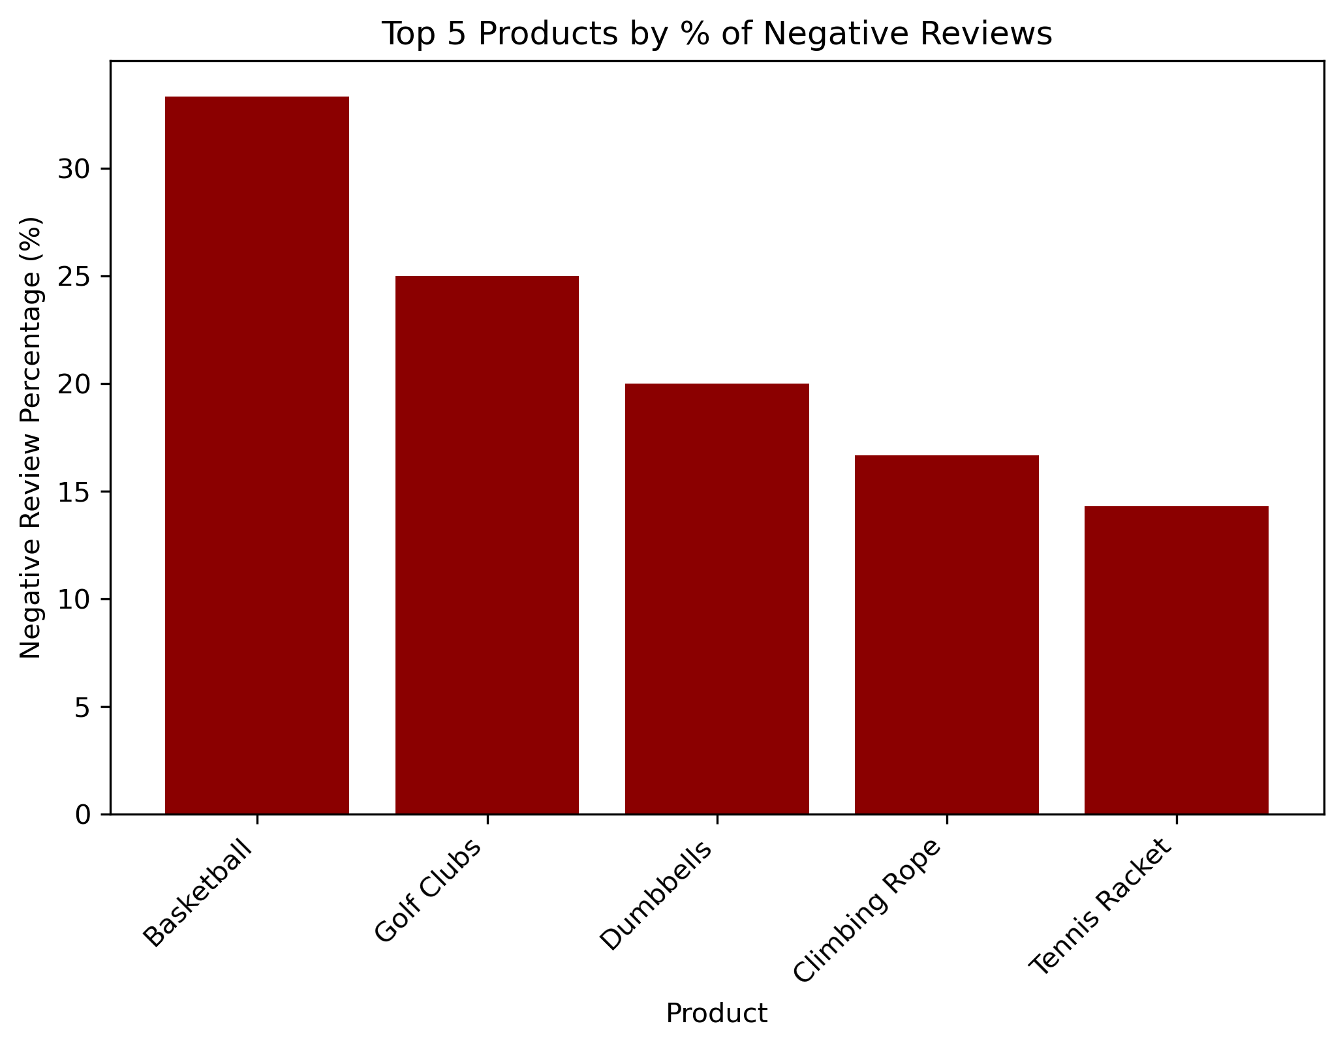
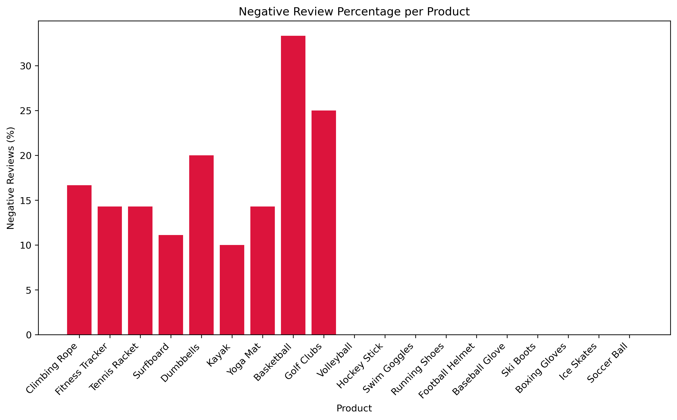
Recommendations
Prioritize fixing the Basketball. It has the highest negative review rate. Investigate and resolve its specific quality or description issues immediately.
Improve accuracy in product listings. Ensure images and descriptions set the right expectations to prevent customer disappointment upon delivery.
Recommendations
Focus on the worst performers first. Prioritize investigating and fixing "Fitness Tracker" and "Tennis Racket" as they have the highest negative review rates.
Improve product quality control. The consistent negative rates across many items suggest a wider quality or supplier issue that needs a full audit.

Slide 12
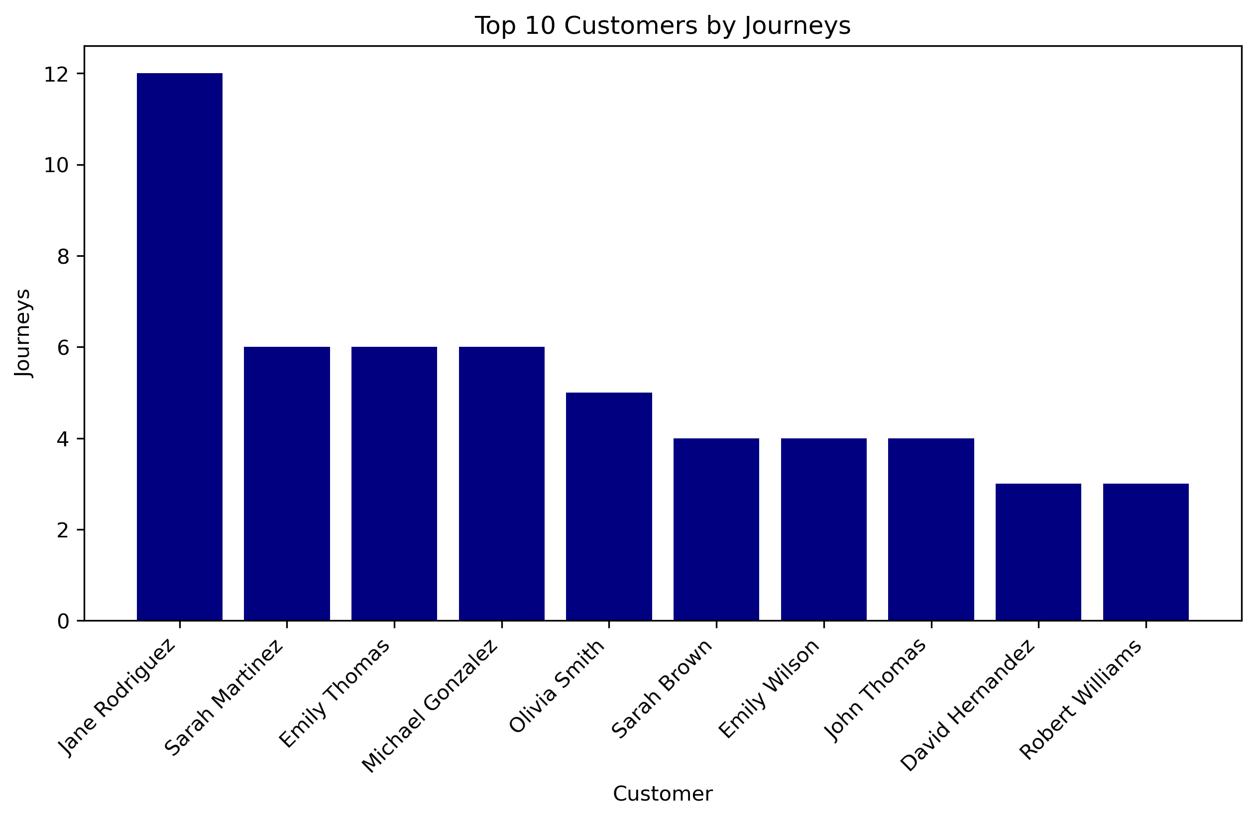
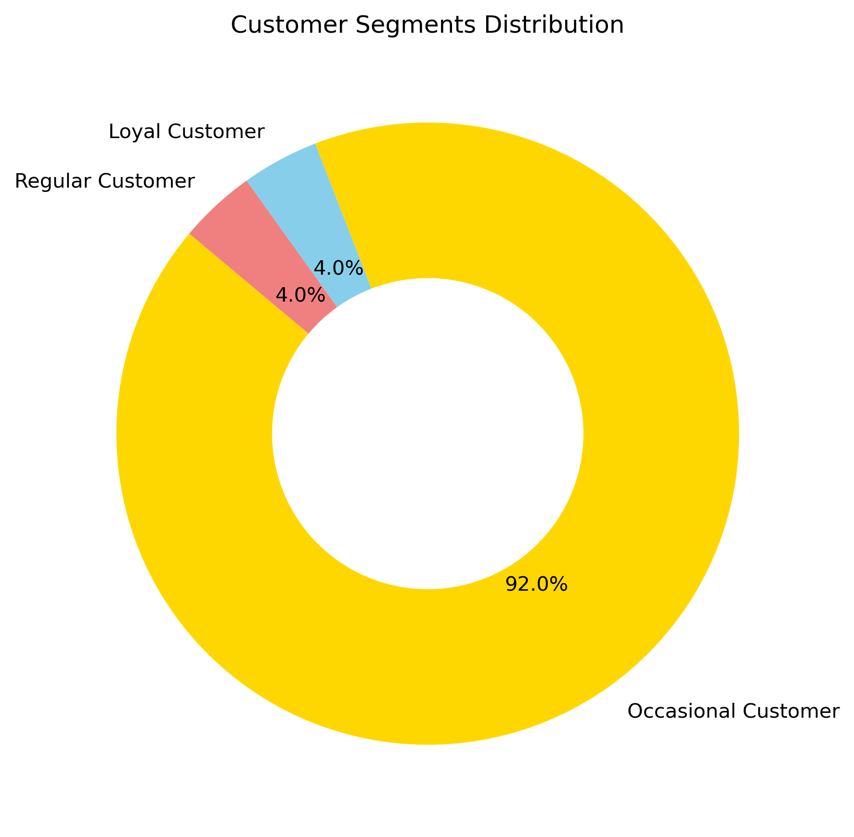
Recommendations
Recommendations
Learn from their behavior. Analyze the common journeys these customers take to understand what drives loyalty and replicate that experience for others.
Personalize their experience. Use their journey history to recommend relevant next steps and make their future interactions even smoother and more valuable.
Protect and reward your loyal base. Your 4% loyal customers are your most valuable asset. Create a loyalty program with exclusive perks to keep them.
Re-engage occasional customers. Win them back with personalized reactivation campaigns or special discounts to move them into the regular segment.

Slide 13
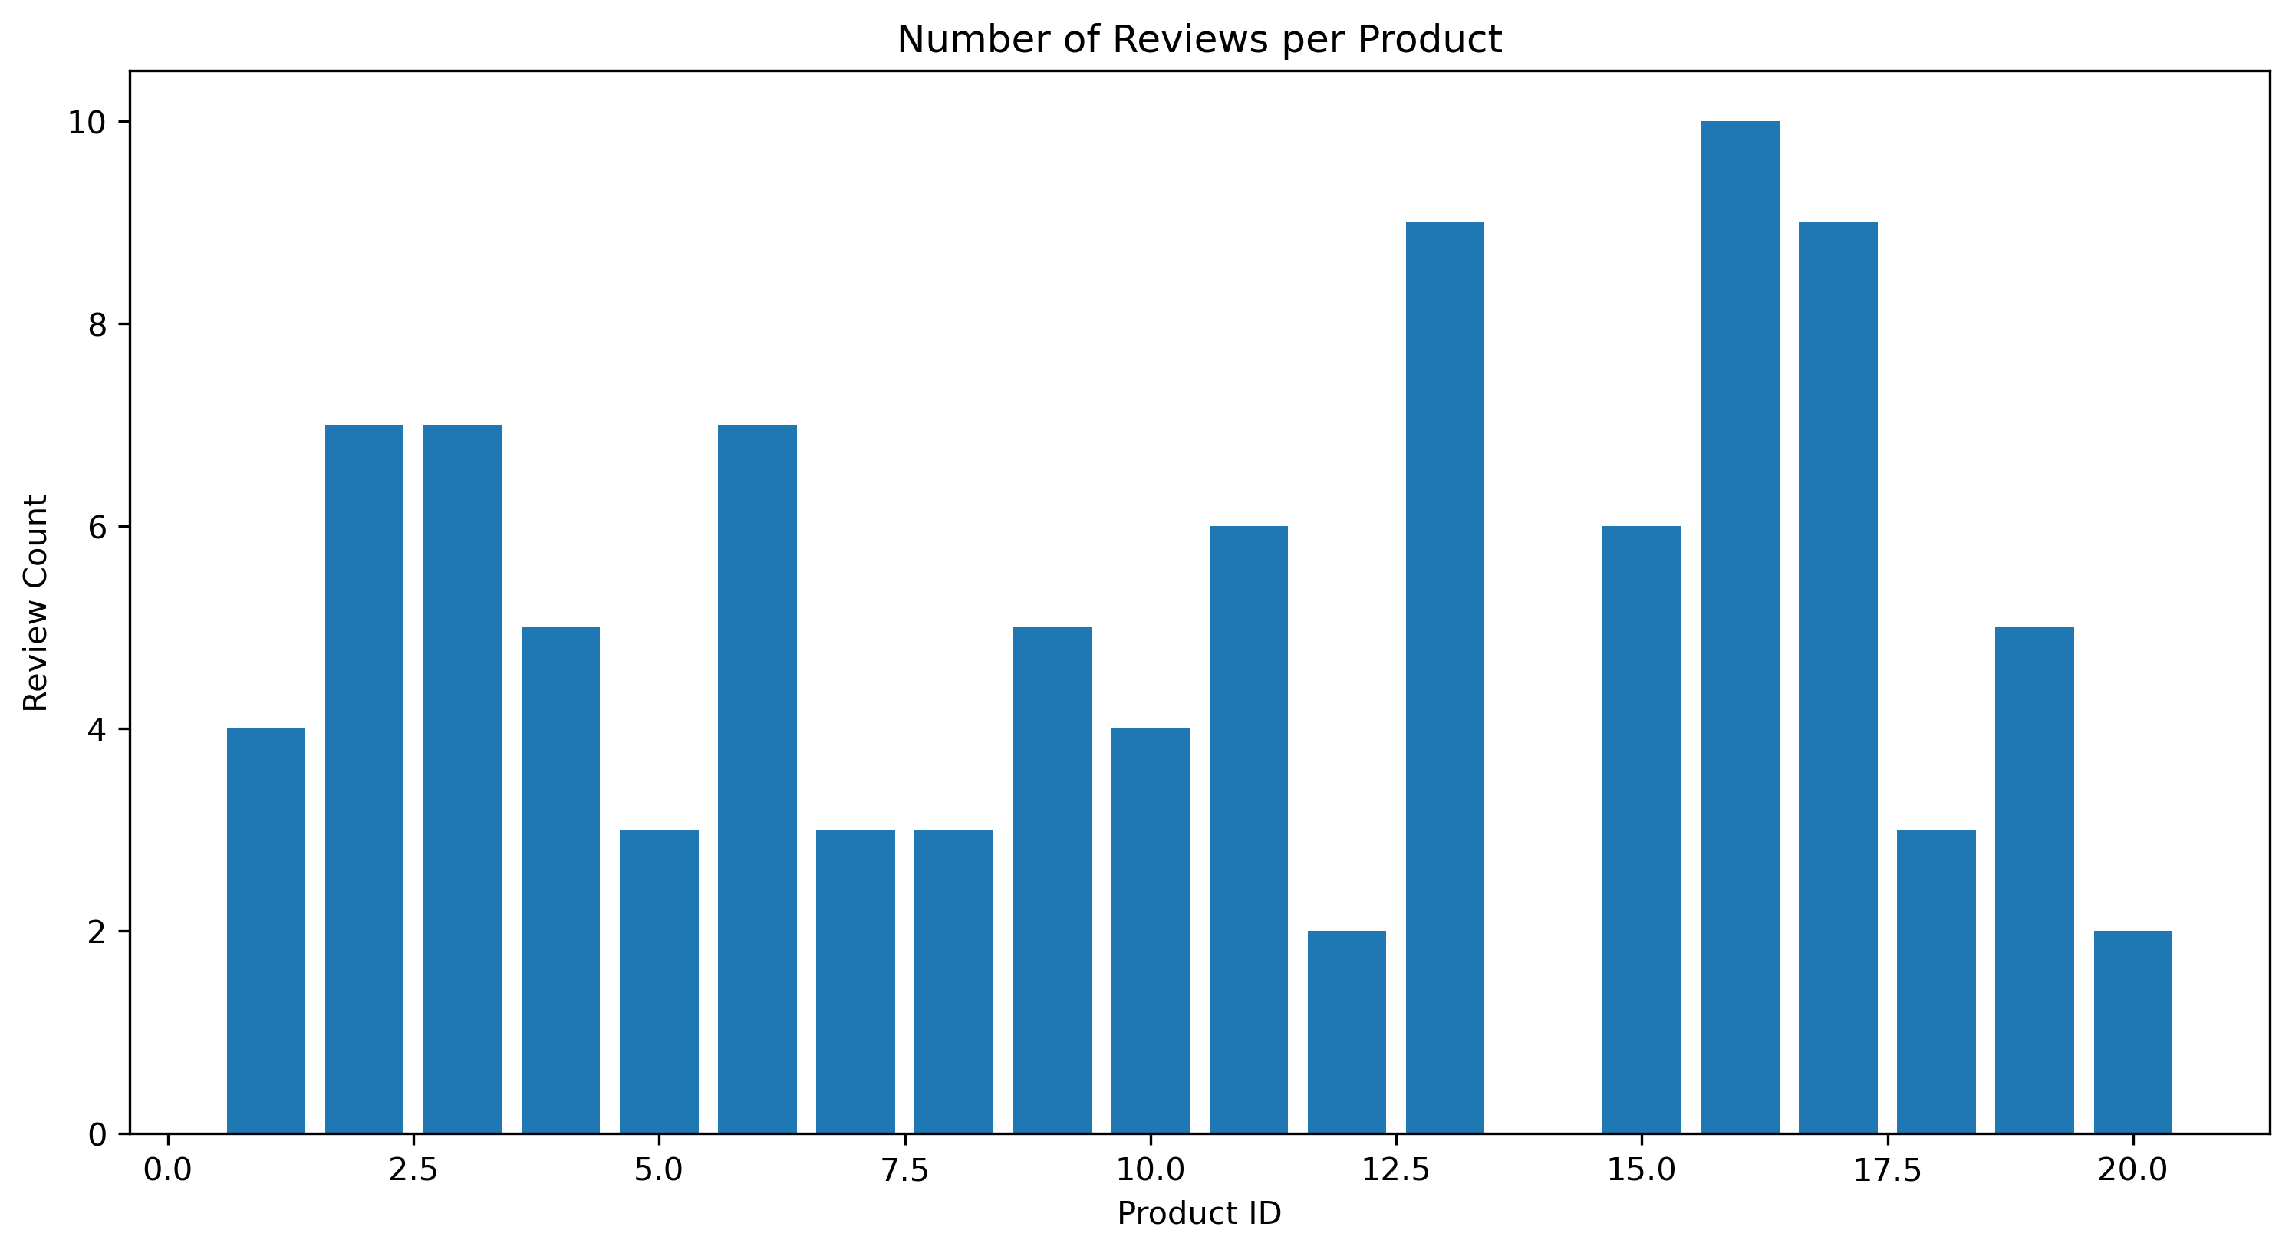
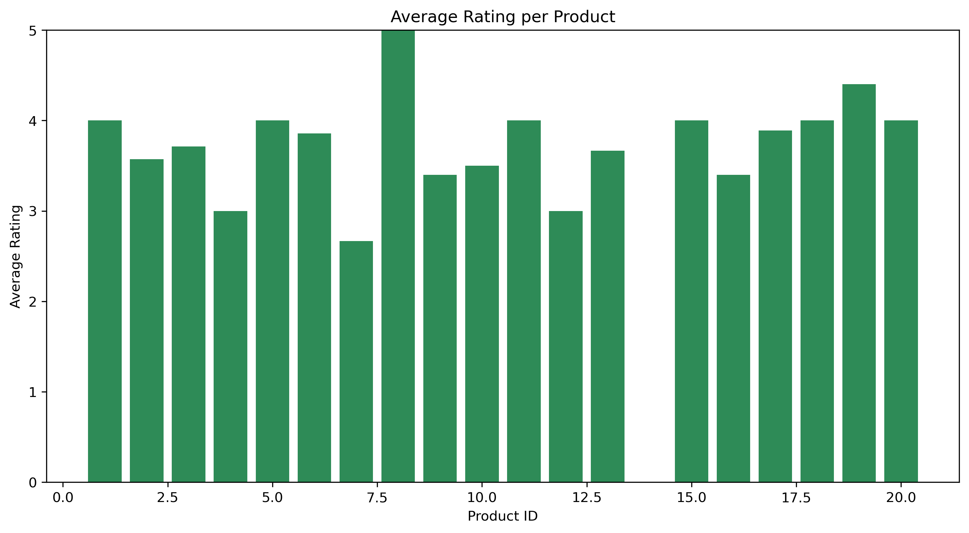
Recommendations
Recommendations
Investigate low-engagement products. Products with very few or no reviews are not being evaluated. Promote them more or offer incentives for first reviews.
Encourage more reviews across the board. Implement a follow-up system to gently ask for feedback after purchase to increase review volume for all products.
Identify and fix low-rated products. Products with ratings below average need immediate attention. Investigate the root cause of dissatisfaction.
Promote and learn from top-rated products. Highlight your high-scoring products in marketing. Analyze what makes them successful and replicate it.

Slide 14
Marketing Effectiveness

Slide 15
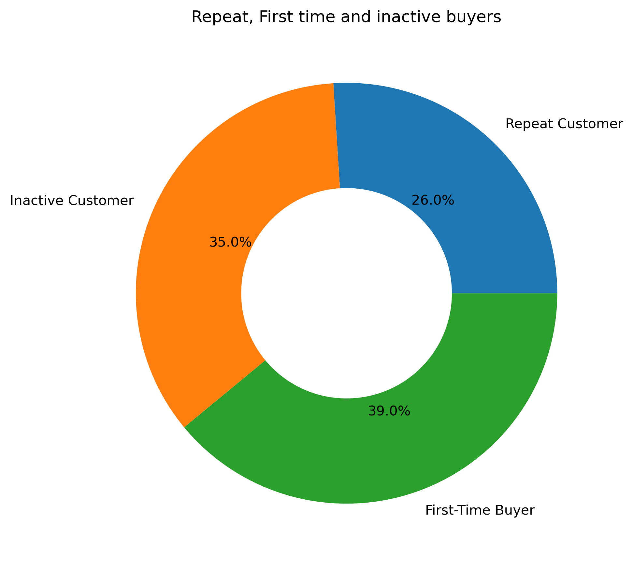
Recommendations
Focus on converting first-time buyers. 39% are new customers. Create a great post-purchase experience and targeted offers to turn them into repeat buyers.
Re-engage inactive customers. Win back the 35% who haven't returned with "we miss you" discounts or notifications about new products.
Reward and retain repeat buyers. Your 26% repeat customers are your core business. Build a loyalty program to keep them engaged and prevent them from becoming inactive.

Slide 16
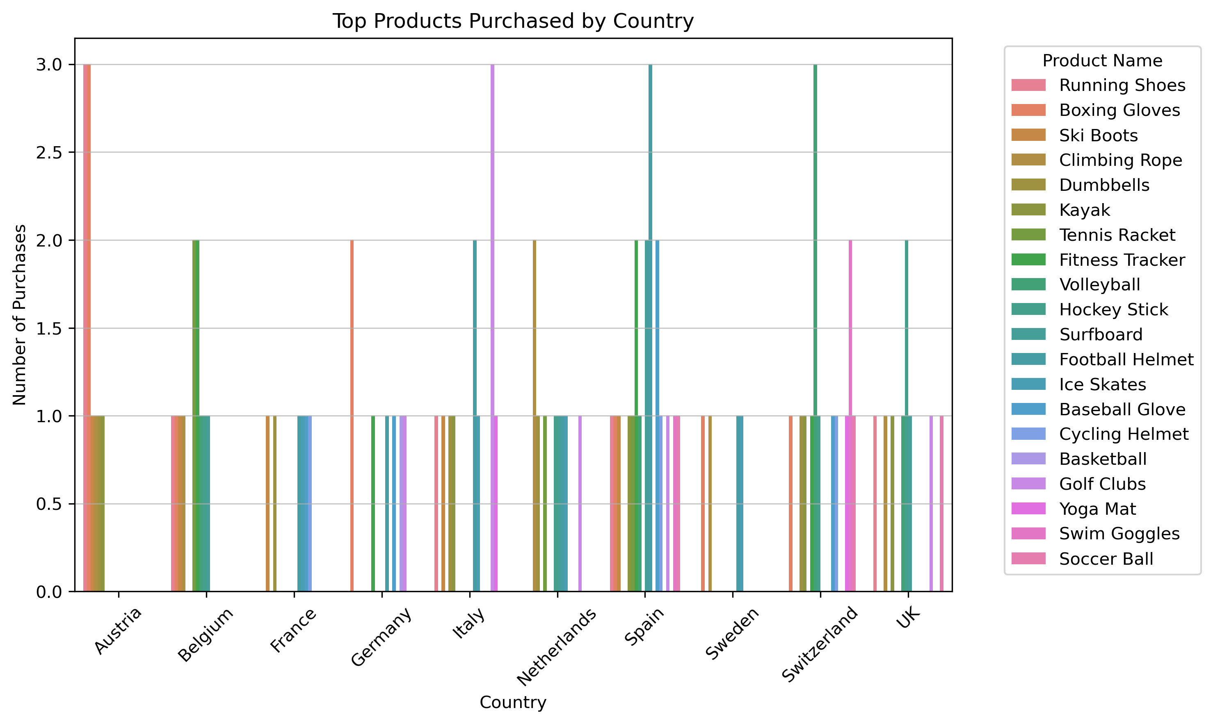
Recommendations
Stock best-sellers by region. For example, ensure "Running Shoes" are well-stocked in Germany and the UK, where they are most popular.
Tailor marketing to local preferences. Promote "Ski Boots" and "Cycling Helmets" in Switzerland and Austria, where interest is higher.
Explore underperforming markets. Investigate why products like "Soccer Balls" have low sales in Spain or Italy and adjust strategy there.

Slide 17
Thank you

